Slide 1
Approximate Computing
Marvin Sevilla

Slide 2
Overview
What is Approximate Computing
Real Life Examples
Practical Applications
Under The Hood
Image Algorithm Demo
Practical Coding Demo
Closing Remarks

Slide 3
What is Approximate Computing
What is the point of approximate computing?
To achieve a satisfactory computational result with reliable and controllable error thresholds, in other words: relaxed precision. Basically, as Jie Han form the University of Alberta puts it, "...[it] employs active design methodologies that exploit the nature that many systems and applications can tolerate some loss of accuracy in the computation result."
Where does approximate computing help?
Approximate computing covers things from programming language all the way down to circuit design and transistor/logic-gate scrutiny. It helps improve energy efficiency while maintaining a satisfactory level of computational accuracy.
Where might approximate computing be beneficial?
Definitely in computing clusters used for deep learning or LLMs. The amount of heat generated from those clusters is enormous and requires a ton of power to keep cool. Reducing the amount of energy needed to power the clusters and cool them would mean money saved, cheaper and smaller hardware, and more computational efficiency per unit of space in such a facility.

Slide 4
What is Approximate Computing
How does approximate computing get all of this done?
Voltage Scaling + Dynamic Voltage and Frequency Scaling (DVFS). This means reducing the operating voltage of the processor. The technique even goes as far as to adjust the voltage dynamically based on the input/workload.
Error Resilient Algorithms
Algorithms such as the Newton-Raphson method, lossy compression (like JPEG), sorting algorithms like TeraSort (which highly performant but slightly imprecise),
Application Approximation
This means instead of approximating the entirety of an application, we approximate only parts of it while leaving other parts of it with higher levels of accuracy
Quality-Aware Programming
A programming tactic which requires that software developers be keenly aware and constantly attempting to reduce the space complexity of a program as much as possible.
If the relaxed version of a program is different to the original, when will they converge? When can they be related again?
There are synchronization points where the 2 converge, and often times those
We bring the assertion or result to a previous (or sometimes future) synchronization point and verify it there
Verification reuses existing reasoning from the original program
Languages such as Coq analyze raw source code using user-given inference rules to validate logic

Slide 5
What is Approximate Computing
Techniques for computationally faster algorithms that use less energy, yielding inexpensive results of lower quality with negligible error
Levels of Approximate Computing
Logic & Circuit
Microarchitecture (atomic functions)
Algorithms
Parameters
Is undeniably faster and lower-power as it is unreliable

Slide 6
What is Approximate Computing
Classes of Approximate Computing Techniques
Error Occurrence
Either non-deterministic (errors happen randomly) or deterministic (achieve same every time)
Degradation
Concerned with error rates and outcomes
Error rates refer to toggle-able or gradual degradation
Error outcomes refer to
Bounded (Toggleable)
Catastrophic (Togglable and Gradual)
Graceful (Gradual)
Level
Transistor, logic, or algorithmic
Evaluation
Atomic or Application

Slide 7
What is Approximate Computing
The success of an approximated application is its reliability
Reliability looks like executing the process multiple times, and the end-state of the relaxed version matches the original version a specified number of times, we deem the program reliable to that point

Slide 8
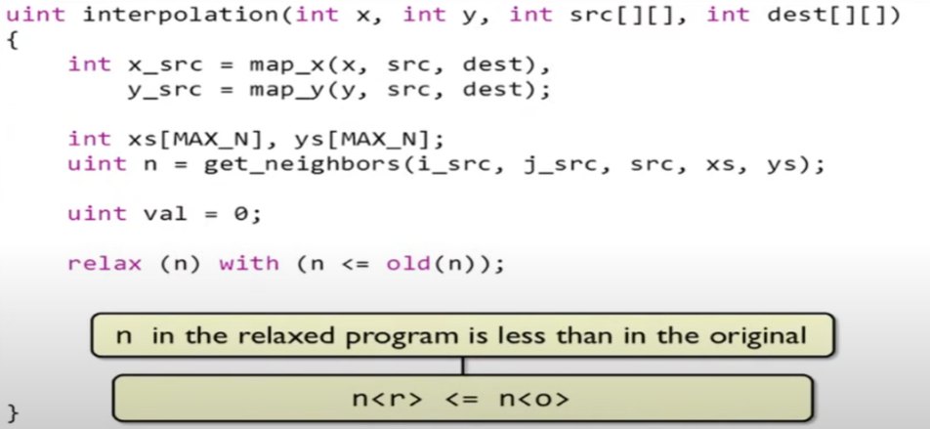
What is Approximate Computing

Slide 9
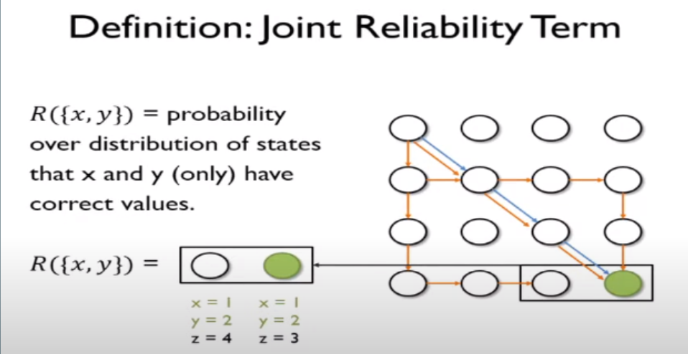
What is Approximate Computing

Slide 10
Real Life Examples
Often used to meet project budget or time requirements
Well known approximation methods include fixed point, block floating point, and floating point
"...approximate computing techniques need to exploit the error-tolerance of humans and neural networks. This optimization can lead to lightweight neural networks." (21, Srivastava, Srishti, et al. "A Survey of Deep Learning Techniques for Vehicle Detection from UAV Images." CSE Department, IIT Dharwad, India, ECE Department, NIT Trichy, India, ECE Department, IIT Roorkee, India, 2024.)
Stochiastic/Probabilistic Computing, which is designed to infer based on data (e.g. a person buys yoga pants, a set of dumbbells, books on nutrition: make an inference). Requires testing many scenarios and noting features that are freqently present in all scenarios

Slide 11
Real Life Examples
Video Compression
Image Compression
Max Pooling
ANSYS Mesh Density
Function Approximation
Single vs. Double Precision GPU computation with Roofline Graph

Slide 12
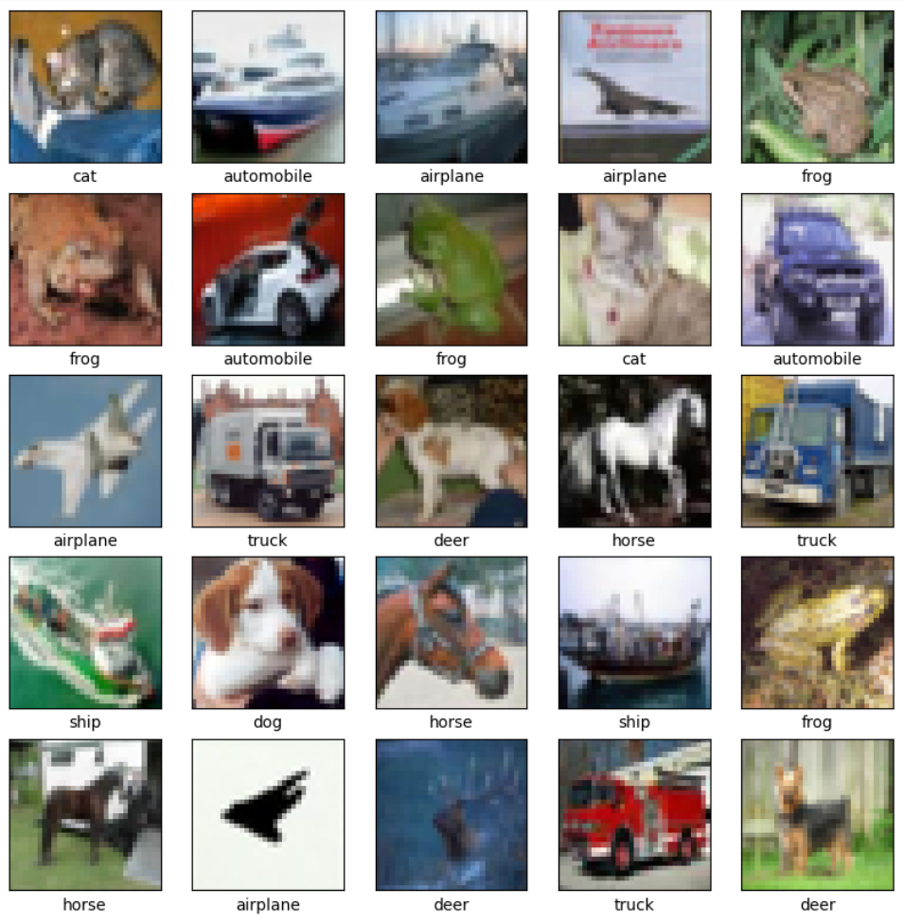
Real Life Examples

Slide 13
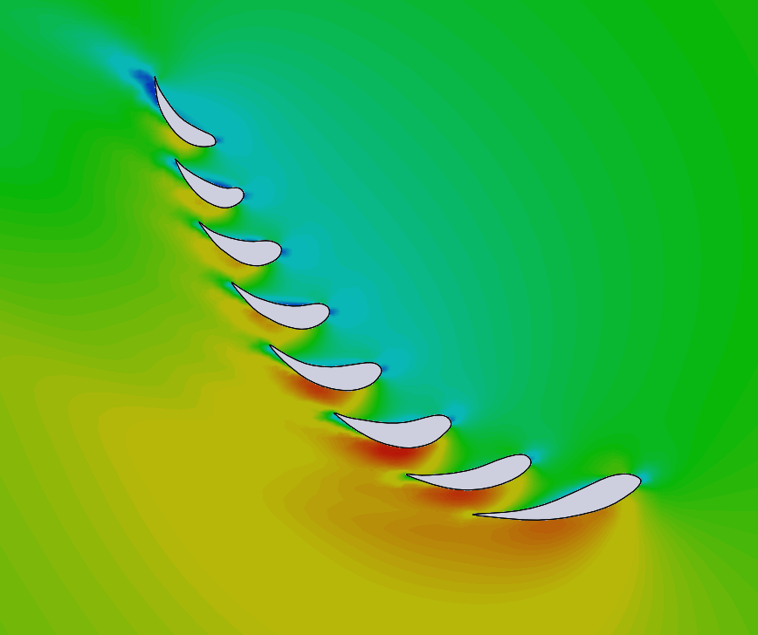
Real Life Examples

Slide 14
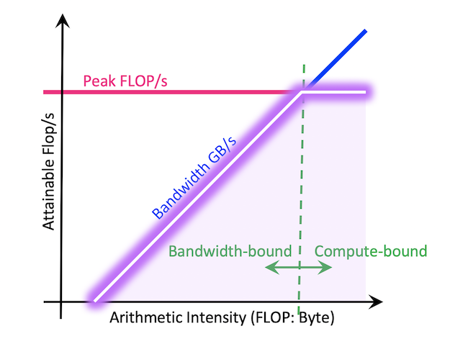
Real Life Examples

Slide 15
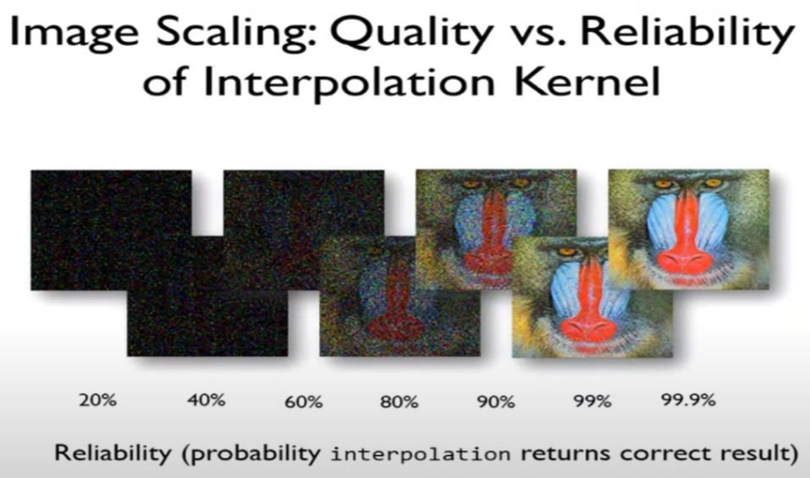
Real Life Examples

Slide 16
Practical Applications
Code Perforation, Function Substitution, Approximate Memoiztation, Relaxed Synchronization (Lock Elision), Approximate Hardware
For example, choosing between using single and half precision numbers is a difference of ~3 bytes/13 bits
In unreliable hardware such as: an ALU that concludes 2+2 = 6 or Secondary Memory that interprets the memory location 0x3452 (12 in decimal) but retrieves from decimal memory location 40

Slide 17
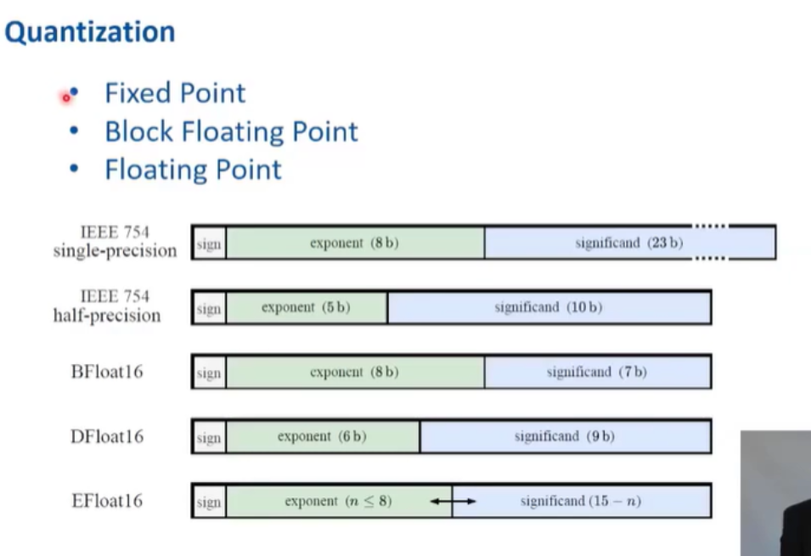
Practical Applications

Slide 18
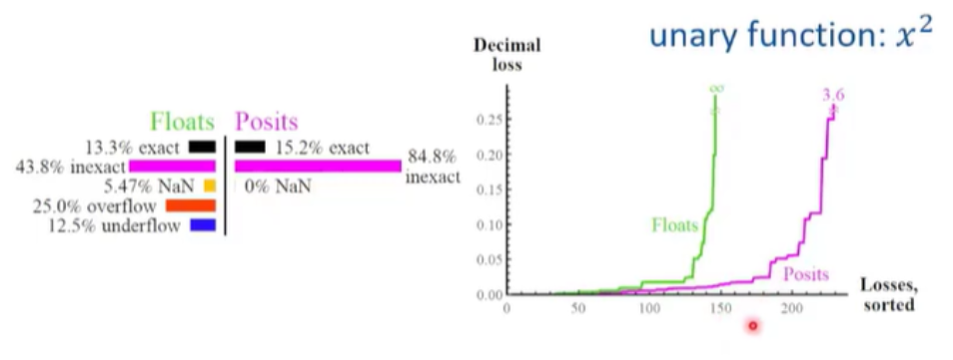
Practical Applications

Slide 19
Under The Hood
General Steps
Achieve minimal error result
Establish safe execution envelope
Relax semantics of program
Verify program result
Uses assertions (e.g. a / b such that b ≠ 0, where b≠0 is the assertion)
Prominent concerns with radically inaccurate results, rarely correct results, crashes or other malicious actions
These concerns are avoided via error bounding

Slide 20
Under The Hood
First thing’s first: develop quantitative verification systems
E.g. functions that verify the reliability of values or operations

Slide 21
Under The Hood
Error Resilience Domains are application environments where approximate results are acceptable
Human Perception (e.g. things we can’t hear)
Data Redundancy (e.g. noisy data)
Generally, areas that have “No Golden Result”
End performance can be measured via things like data processing and feature extraction
Data processing refers to the quality of filtering, compression, or equivalent action which can be measured by human perception
Feature extraction refers to the identification of properties or characteristics of a data instance using algorithms/methods

Slide 22
Under The Hood
Quantified Reliability
.99 * R(x,y,src,dest) <= rd(val) * op(*.) * R(val)
In English:
Specified Bound * Reliability of Operation <= the probability we read the value right * the probability the operand performs right * the probability that the input value itself is right
Then, we evaluate the reliability of everything (e.g. reading, writing, arithmetic, the representation of values themselves
It’s important that we use reliable inputs (determined by a function that measures their reliability), because if we put junk in, we get junk out

Slide 23
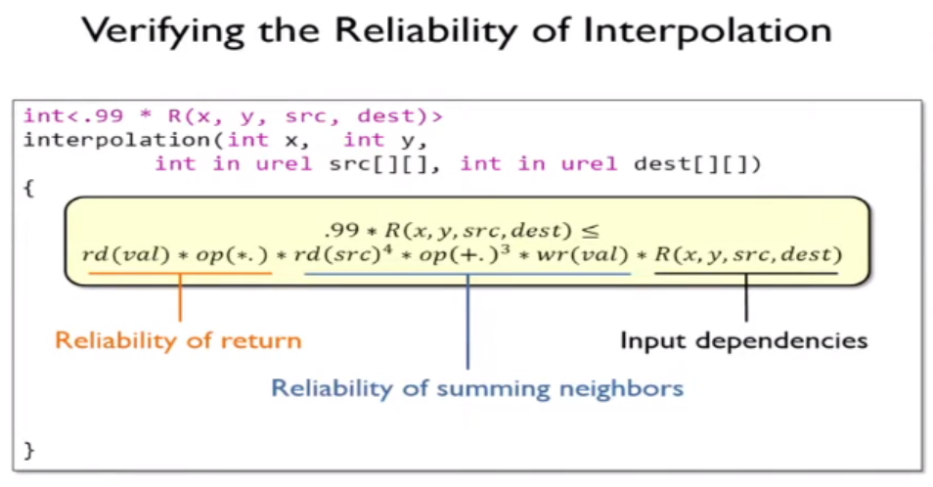
Under The Hood

Slide 24
Under The Hood
Ultimately,
Probability operations must stay within the established acceptable error threshold
Computations must still meet reliability requirements (though tolerant of errors) which can be ensured using error detection and correction mechanisms or algorithmic adjustments that compensate for potential errors
Error-tolerant software must be tested, validated, or verified at an appropriate frequency to ensure reliable results despite the uncertainties introduced by the computer’s hardware or lower-level processes

Slide 25
Image Algorithm Demo

Slide 26
Practical Coding Demo

Slide 27
Closing Remarks

